Slide 1
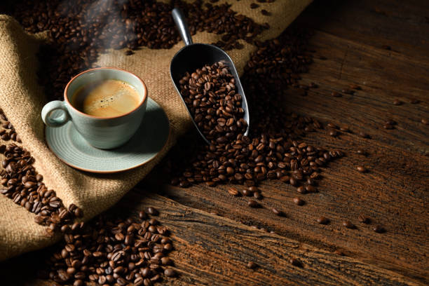
Coffee-Exploration
The Data Analysis and Visualization Boot Camp at Texas McCombs School of Business
- Final Project
Analytics Team:
Michael Andia
Blake Bartlett
Christopher Duke
Tim McCarthy
Krissina Wells

Slide 2

Introduction:
Background
Coffee Varieties: Coffee is a diverse beverage with a wide range of varieties, each offering unique flavor profiles influenced by factors like origin, processing methods, and growing conditions.
Importance of Coffee Ratings: Coffee ratings play a crucial role in helping consumers identify quality coffee. These ratings are often based on expert tasting notes that assess attributes such as acidity, aroma, body, and flavor.
Challenges in Selecting Coffee: With the vast number of coffee varieties available, choosing the right coffee can be overwhelming, especially for beginners. The lack of accessible, clear information adds to the complexity of making informed decisions.
Project Motivation
Helping Coffee Enthusiasts: Our project aims to leverage machine learning to simplify the coffee selection process. By predicting coffee ratings and providing personalized recommendations, we hope to guide coffee enthusiasts in discovering the best coffee that matches their preferences.

Slide 3
Objectives:
Develop an Interactive Coffee Recommendation Model:
Utilize a comprehensive coffee dataset to build a model that analyzes consumer preferences, such as taste, budget, and origin, to provide personalized coffee recommendations.
Enhance User Experience through Data Visualization:
Implement advanced data visualization techniques in Tableau to allow users to interact with and explore the coffee dataset, providing insights into coffee varieties and preferences.
Ensure Data Integrity and Consistency:
Scrape, clean, and process data from www.coffeereview.com, standardizing key variables like cost and volume to ensure consistent and accurate analysis across the dataset.
Leverage Machine Learning for Accurate Predictions:
Apply machine learning techniques to predict coffee ratings based on features such as aroma, acid, body, flavor, and aftertaste, enhancing the recommendation model's accuracy.

Slide 4

Dataset Overview:
Source:
The dataset was scraped from Coffee Reviews.com, capturing detailed information on various coffee varieties, including type, cost per 12 ounces, origin, roast level, flavor profile, and ratings for Aroma, Acid, Body, Flavor, and Aftertaste.
Data Cleaning:
The dataset was meticulously cleaned to handle missing values, standardize costs to US dollars per 12 ounces, and normalize weights from grams to ounces.
Text data was processed by removing stopwords, punctuation, and converting text to lowercase for consistency.
Data Structure:
The final dataset is structured to include key variables such as:
Cost (standardized to USD per 12 oz)
Origin (country of origin)
Roast Level (light, medium, dark)
Description (processed textual data)
Ratings (Aroma, Acid, Body, Flavor, Aftertaste on a 0-20 scale)

Slide 5

Background
Coffee Collection:
Coffee cherries are handpicked at peak ripeness, often in mountainous regions. Only the best, ripe cherries make the cut.
The cherries are processed either through wet or dry methods to extract the beans. This step is crucial for developing the beans' flavor profile.
Bean Processing:
In wet processing, beans are fermented to remove the sticky pulp, then washed to reveal the green coffee beans.
Beans are spread out in the sun to dry, reducing moisture content and preparing them for roasting. This step is vital for preventing spoilage.
Roasting Process:
Green beans are roasted at high temperatures, transforming them into the aromatic, brown beans we recognize. Roasting brings out the beans' unique flavors, whether it’s a light, fruity profile or a deep, smoky taste.
After roasting, the beans are quickly cooled to stop the process and lock in the flavor.
Brewing a Perfect Cup:
Beans are ground to the appropriate coarseness for the brewing method—fine for espresso, coarse for French press.
Hot water is passed through the grounds, extracting the rich flavors and aromas. Whether it's a bold espresso or a smooth pour-over, this step is where the magic happens.

Slide 6

The Most Common Coffee Tasting Descriptions
Acidity Acidity in coffee is something you'll notice once you know what to look for. It's often described as having a fruity or citrusy taste, like lemons, oranges, or berries. Some people like the sharp, lively feel it gives, while others might not. High acidity coffees feel bright and vibrant, while low acidity coffees are smoother and milder.
Flavor The flavor of coffee can be compared to a variety of different tastes and smells. Since every batch of beans is unique, describing flavor is often based on personal opinion. With practice, you'll start to recognize certain flavors that appear in different coffees and figure out what you like. Some people enjoy rich, savory flavors like tobacco or wine, while others prefer sweeter, milder flavors like cinnamon or honey.
Finish/ Aftertaste The coffee experience doesn't end when you swallow. Pay attention to the aftertaste left in your mouth—some coffees will have a strong, lingering flavor, while others might be much milder. Common aftertastes include sweetness and bitterness.
Aroma Aroma is the smell of the coffee, and it's often the first thing you'll notice when you take a sniff. It helps you pick up on the different layers of flavors that might be more subtle.
Body/ Mouthfeel The body of a coffee is about how it feels in your mouth after you take a sip. Some coffees will feel heavier or thicker on your tongue, similar to how whole milk feels richer than skim milk. To really understand the body, try letting the coffee sit on your tongue for a moment before swallowing to get a sense of its texture. People often describe the body of a coffee with words like 'full', 'heavy', 'light', 'oily', or 'airy'.
Sweetness Sweetness is something most people recognize easily when tasting or smelling. It's a good starting point for learning to describe coffee flavors. Can you taste or smell a sugary quality in the coffee? If so, what kind of sweetness is it? Some coffees might remind you of brown sugar or molasses, while others might have hints of honey or agave.

Slide 7

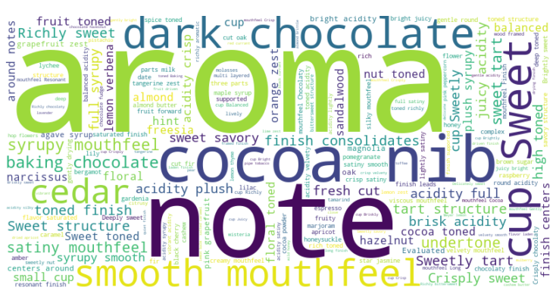
Notes:
We created the word cloud by first selecting relevant text data column and then cleaning it by removing common stopwords, punctuation, and converting everything to lowercase for consistency.
We then calculated the frequency of each word to determine its prominence in the word cloud. Using a word cloud generator, we input the processed text, adjusting the shape and colors to highlight key themes.
The result visually represents the most frequent terms, allowing for a quick grasp of the main ideas within the dataset

Slide 8
Results:
Model Performance:
We used a Random Forest Regressor, which combines multiple decision trees to predict coffee ratings. The model was wrapped in a pipeline for consistent preprocessing.
After tuning, the best model achieved an RMSE of 0.3948, indicating strong predictive accuracy and a good fit with the test data.
Data Visualizations and Key Insights:
Roaster Distribution and Price-Rating Correlation: Our Tableau visualizations reveal that high-quality coffee roasters are often clustered in specific regions, likely tied to traditional coffee-growing areas or strong coffee cultures. Additionally, while higher prices generally correlate with better ratings, there are notable exceptions, with some mid-priced coffees achieving high ratings. This suggests that factors beyond price, such as origin and roast quality, play a crucial role in determining coffee quality.

Slide 9
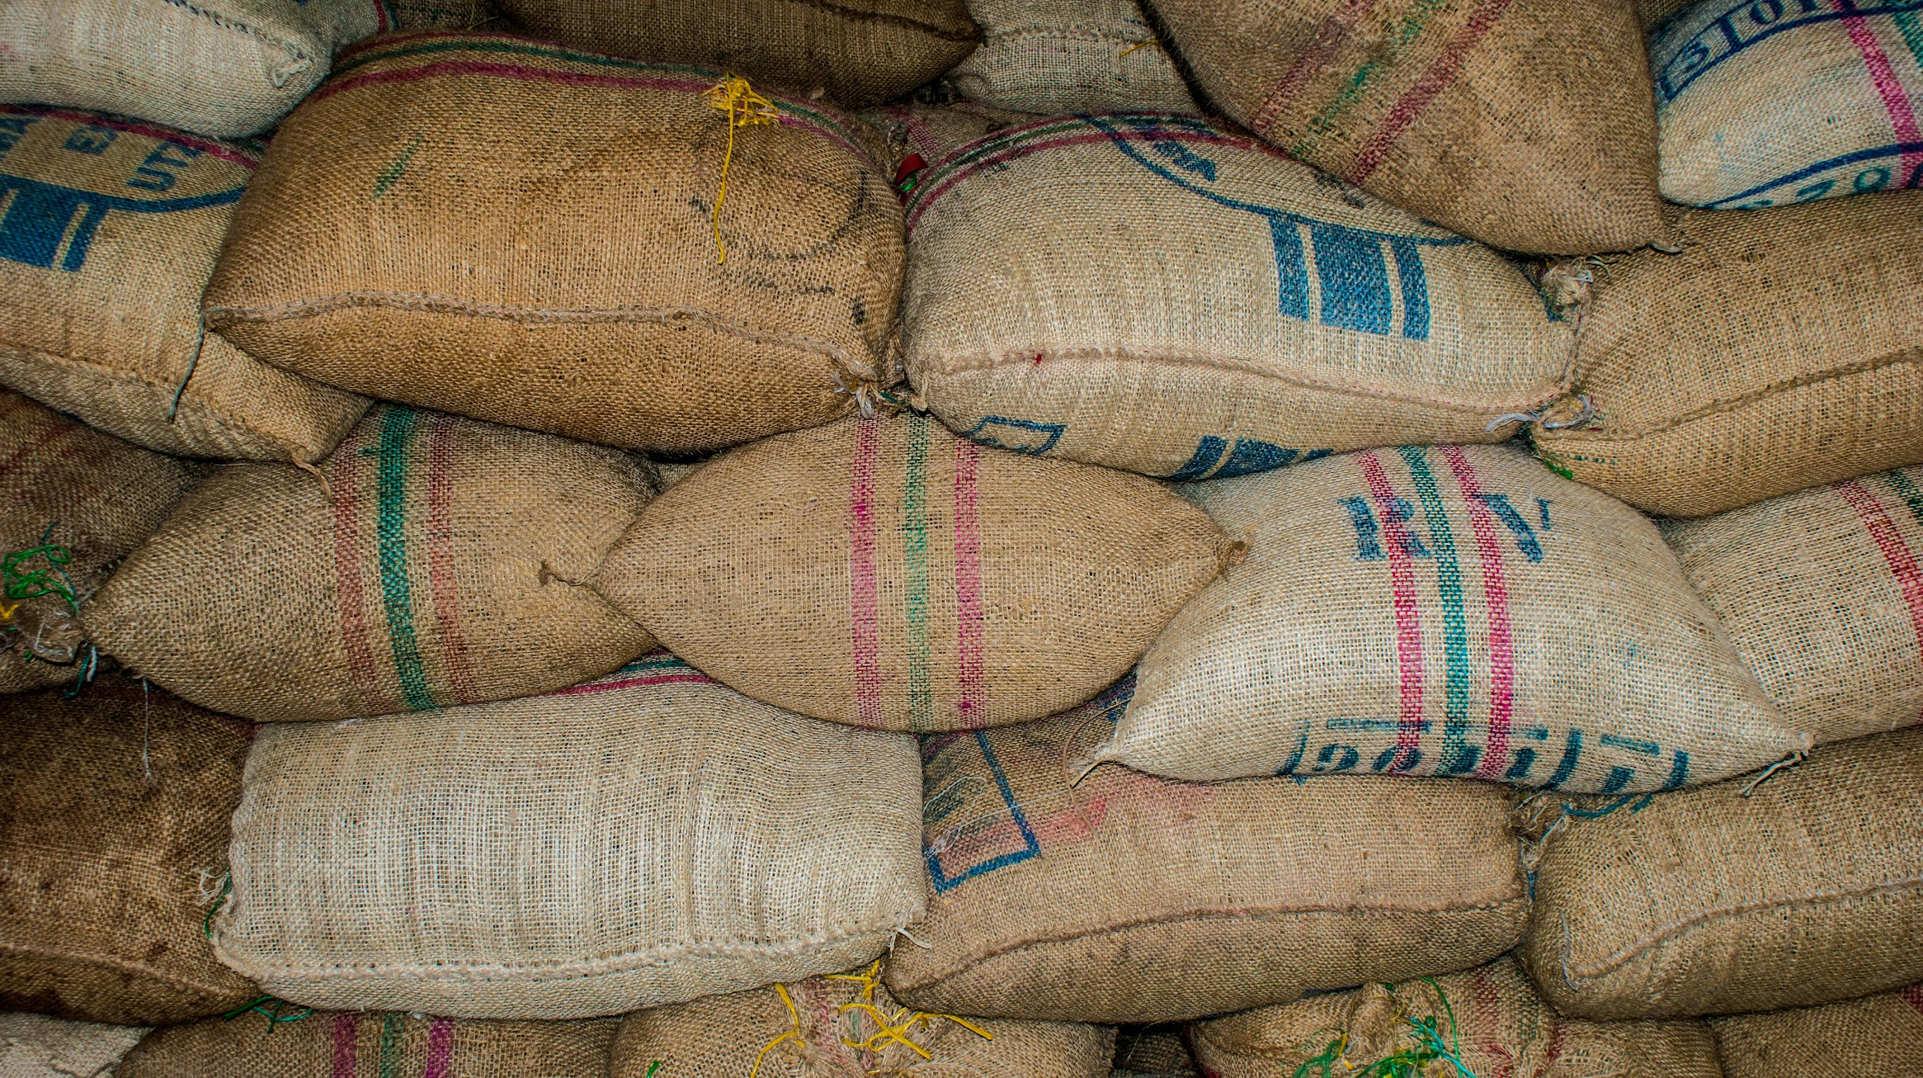
Limitations, Improvements, and Future work:
Data Limitations:
We faced issues with inaccurate geocoding when mapping coffee origins due to multiple countries listed in a single column. This led to incorrect coordinates, underscoring the need for clean, well-structured data in location-based analysis.
Improvements:
We plan to enhance the model by incorporating additional data sources, such as reviews from other platforms, to better represent lower-rated coffees. We'll also manually validate geocoded locations, especially for coffees with multiple origins, to improve data accuracy and prediction reliability.
Future Work:
Sustainability Scoring: Introduce a sustainability score for each coffee variety, taking into account factors like fair trade certification, organic farming practices, and environmental impact.
Consumer Behavior Over Time: Conduct a longitudinal study to analyze how consumer preferences evolve over time, and adjust the recommendation algorithm to reflect these changes.
Notes:
Data Limitations:
Challenge with Geoapify Data: We encountered significant issues when attempting to map the origin of coffee beans due to inaccuracies in the geocoding process. This was primarily because our dataset included multiple countries of origin within a single entry, leading to confusion in determining accurate coordinates. This experience highlighted the critical need for clean, well-structured data, especially in location-based analysis.
Improvements:
Enhancing Predictive Model: To improve our model and recommendations, we will focus on integrating additional data sources, particularly those that provide insights into lower-rated coffees. This will include pulling in more consumer reviews from other platforms and incorporating detailed product information.
Manual Geocoding Validation: Additionally, we plan to implement a process for manually validating and correcting geocoded locations, particularly for entries with multiple countries of origin, to ensure greater accuracy and reliability in our predictions.
Future Work:
Sustainability Scoring: Looking ahead, we aim to introduce a sustainability score for each coffee variety, considering factors like fair trade certification, organic farming practices, and environmental impact, aligning with the increasing consumer demand for sustainability.
Consumer Behavior Over Time: We also plan to conduct a longitudinal study to track how consumer preferences evolve. This will allow us to refine our recommendation algorithm to reflect these changing preferences over time, ensuring that our model stays relevant and accurate.

Slide 10
Conclusion:
Conclusion:
The Random Forest model, optimized through hyperparameter tuning, achieved an RMSE of 0.3948, indicating strong predictive accuracy for coffee ratings.
This result demonstrates the model's reliability and effectiveness in capturing key patterns within the data. Further improvements could enhance accuracy, but the current model provides a solid foundation for predictive analysis.
Takeaways:
Data Quality and Preparation are Crucial
Model Tuning Improves Accuracy
Cross-Validation Ensures Robustness and reduces the risk of overfitting.
There is potential for Further Improvement such as exploring additional features, trying alternative algorithms, or further refining the current model.
The model's ability to predict coffee ratings has practical implications, such as helping consumers find the best coffee based on their preferences and assisting roasters in understanding factors that influence ratings.

Slide 11

References:
Citations for sources and datasets referenced in and used for our presentation.
Coffee Terminology Retrieved fromhermonoscoffeeroasters.com
Data Source Retrieved from https://www.coffeereview.com/review/
Inspiration and partial code Retrieved from https://www.kaggle.com/code/hanifalirsyad/coffee-scraping/output
Geoapify Geocoding and Mapping API: Geoapify. (2024).Retrieved from https://www.geoapify.com/
OpenAI. (2024). ChatGPT (Version GPT-4). Retrieved from https://chat.openai.com/

